Slide 1

NFL database analysis
Team PK Rippers
Team member: David, Shreya, Faraz, Prexa, Apoorva, Yan
This Photo by Unknown Author is licensed under CC BY-NC-ND

Slide 2
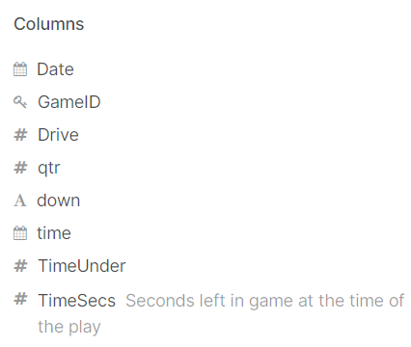

Detailed NFL play-by-play Data 2009-2018
This Photo by Unknown Author is licensed under CC BY

Slide 3
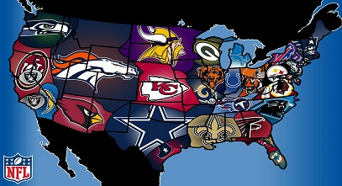
Play type made by teams
400,000
300,000
count
200,000
count
100,000
pass
run
no_play
kickoff
punt
NA
ext...int
fiel...oal
qb...eel
qb...ike
play_type
Notes:
Play_type analysis, focus on two most play made, which are pass and run.
Code:
source="NFL Play by Play 09-18 Updated.csv" | stats count by play_type | sort-count|

Slide 4
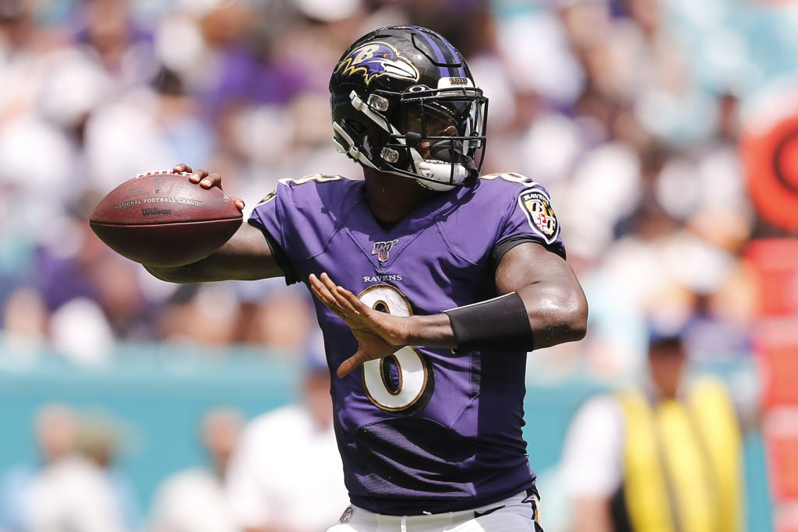
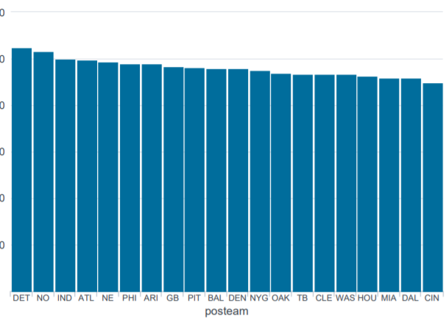
Top 20 teams rank by total “pass” made
Notes:
Total ‘pass’ made by teams are close to each other
Code:
source="NFL Play by Play 09-18 Updated.csv" play_type="pass" | stats count by posteam | sort-count|head 20| fillnull

Slide 5
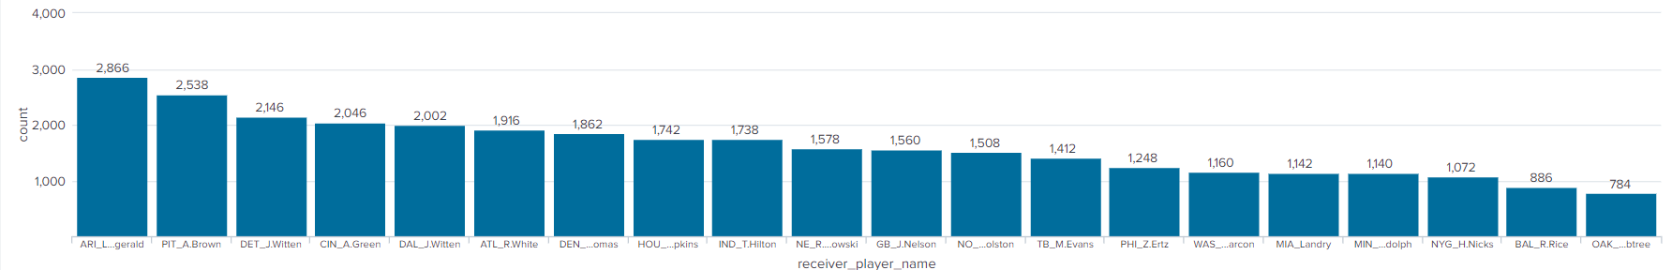

Top players in top 20 team for “pass” made
Notes:
This graph give us best passer in each team. And top player stats in those teams are varying. One of the reason could be some team has multiple passer so the number spread out to players. It also tells that player could potentially stay in team for a long time. Longer they stay, more pass made. Top player in this graph has the least chance switch team.
Code:
source="NFL Play by Play 09-18 Updated.csv" posteam="hou" play_type="pass" | chart count by receiver_player_name | sort - count| head 1 | append[search source="NFL Play by Play 09-18 Updated.csv" posteam="dal" play_type="pass" | chart count by receiver_player_name | sort - count| head 1] |append[search source="NFL Play by Play 09-18 Updated.csv" posteam="det" play_type="pass" | chart count by receiver_player_name | sort - count| head 1] |append[search source="NFL Play by Play 09-18 Updated.csv" posteam="no" play_type="pass" | chart count by receiver_player_name | sort - count| head 1] | append[search source="NFL Play by Play 09-18 Updated.csv" posteam="IND" play_type="pass" | chart count by receiver_player_name | sort - count| head 1]| append[search source="NFL Play by Play 09-18 Updated.csv" posteam="ATL" play_type="pass" | chart count by receiver_player_name | sort - count| head 1]| append[search source="NFL Play by Play 09-18 Updated.csv" posteam="NE" play_type="pass" | chart count by receiver_player_name | sort - count| head 1]| append[search source="NFL Play by Play 09-18 Updated.csv" posteam="PHI" play_type="pass" | chart count by receiver_player_name | sort - count| head 1]| append[search source="NFL Play by Play 09-18 Updated.csv" posteam="ARI" play_type="pass" | chart count by receiver_player_name | sort - count| head 1]| append[search source="NFL Play by Play 09-18 Updated.csv" posteam="GB" play_type="pass" | chart count by receiver_player_name | sort - count| head 1]| append[search source="NFL Play by Play 09-18 Updated.csv" posteam="PIT" play_type="pass" | chart count by receiver_player_name | sort - count| head 1]| append[search source="NFL Play by Play 09-18 Updated.csv" posteam="BAL" play_type="pass" | chart count by receiver_player_name | sort - count| head 1]| append[search source="NFL Play by Play 09-18 Updated.csv" posteam="DEN" play_type="pass" | chart count by receiver_player_name | sort - count| head 1]| append[search source="NFL Play by Play 09-18 Updated.csv" posteam="NYG" play_type="pass" | chart count by receiver_player_name | sort - count| head 1]| append[search source="NFL Play by Play 09-18 Updated.csv" posteam="OAK" play_type="pass" | chart count by receiver_player_name | sort - count| head 1]| append[search source="NFL Play by Play 09-18 Updated.csv" posteam="TB" play_type="pass" | chart count by receiver_player_name | sort - count| head 1]| append[search source="NFL Play by Play 09-18 Updated.csv" posteam="CIN" play_type="pass" | chart count by receiver_player_name | sort - count| head 1]| append[search source="NFL Play by Play 09-18 Updated.csv" posteam="WAS" play_type="pass" | chart count by receiver_player_name | sort - count| head 1]| append[search source="NFL Play by Play 09-18 Updated.csv" posteam="MIA" play_type="pass" | chart count by receiver_player_name | sort - count| head 1]| append[search source="NFL Play by Play 09-18 Updated.csv" posteam="MIN" play_type="pass" | chart count by receiver_player_name | sort - count| head 1]|replace "J.Witten" WITH "DAL_J.Witten" IN receiver_player_name |replace "D.Hopkins" WITH "HOU_D.Hopkins" IN receiver_player_name|replace "C.Johnson" WITH "DET_J.Witten" IN receiver_player_name| replace "M.Colston" WITH "NO_M.Colston" IN receiver_player_name|replace "T.Hilton" WITH "IND_T.Hilton" IN receiver_player_name|replace "R.White" WITH "ATL_R.White" IN receiver_player_name|replace "R.Gronkowski" WITH "NE_R.Gronkowski" IN receiver_player_name|replace "Z.Ertz" WITH "PHI_Z.Ertz" IN receiver_player_name|replace "L.Fitzgerald" WITH "ARI_L.Fitzgerald" IN receiver_player_name|replace "J.Nelson" WITH "GB_J.Nelson" IN receiver_player_name|replace "A.Brown" WITH "PIT_A.Brown" IN receiver_player_name|replace "R.Rice" WITH "BAL_R.Rice" IN receiver_player_name|replace "D.Thomas" WITH "DEN_D.Thomas" IN receiver_player_name|replace "H.Nicks" WITH "NYG_H.Nicks" IN receiver_player_name|replace "M.Crabtree" WITH "OAK_M.Crabtree" IN receiver_player_name|replace "M.Evans" WITH "TB_M.Evans" IN receiver_player_name|replace "P.Garcon" WITH "WAS_P.Garcon" IN receiver_player_name|replace "J.Landry" WITH "MIA_Landry" IN receiver_player_name| replace "A.Green" WITH "CIN_A.Green" IN receiver_player_name|replace "K.Rudolph" WITH "MIN_K.Rudolph" IN receiver_player_name|sort-count

Slide 6
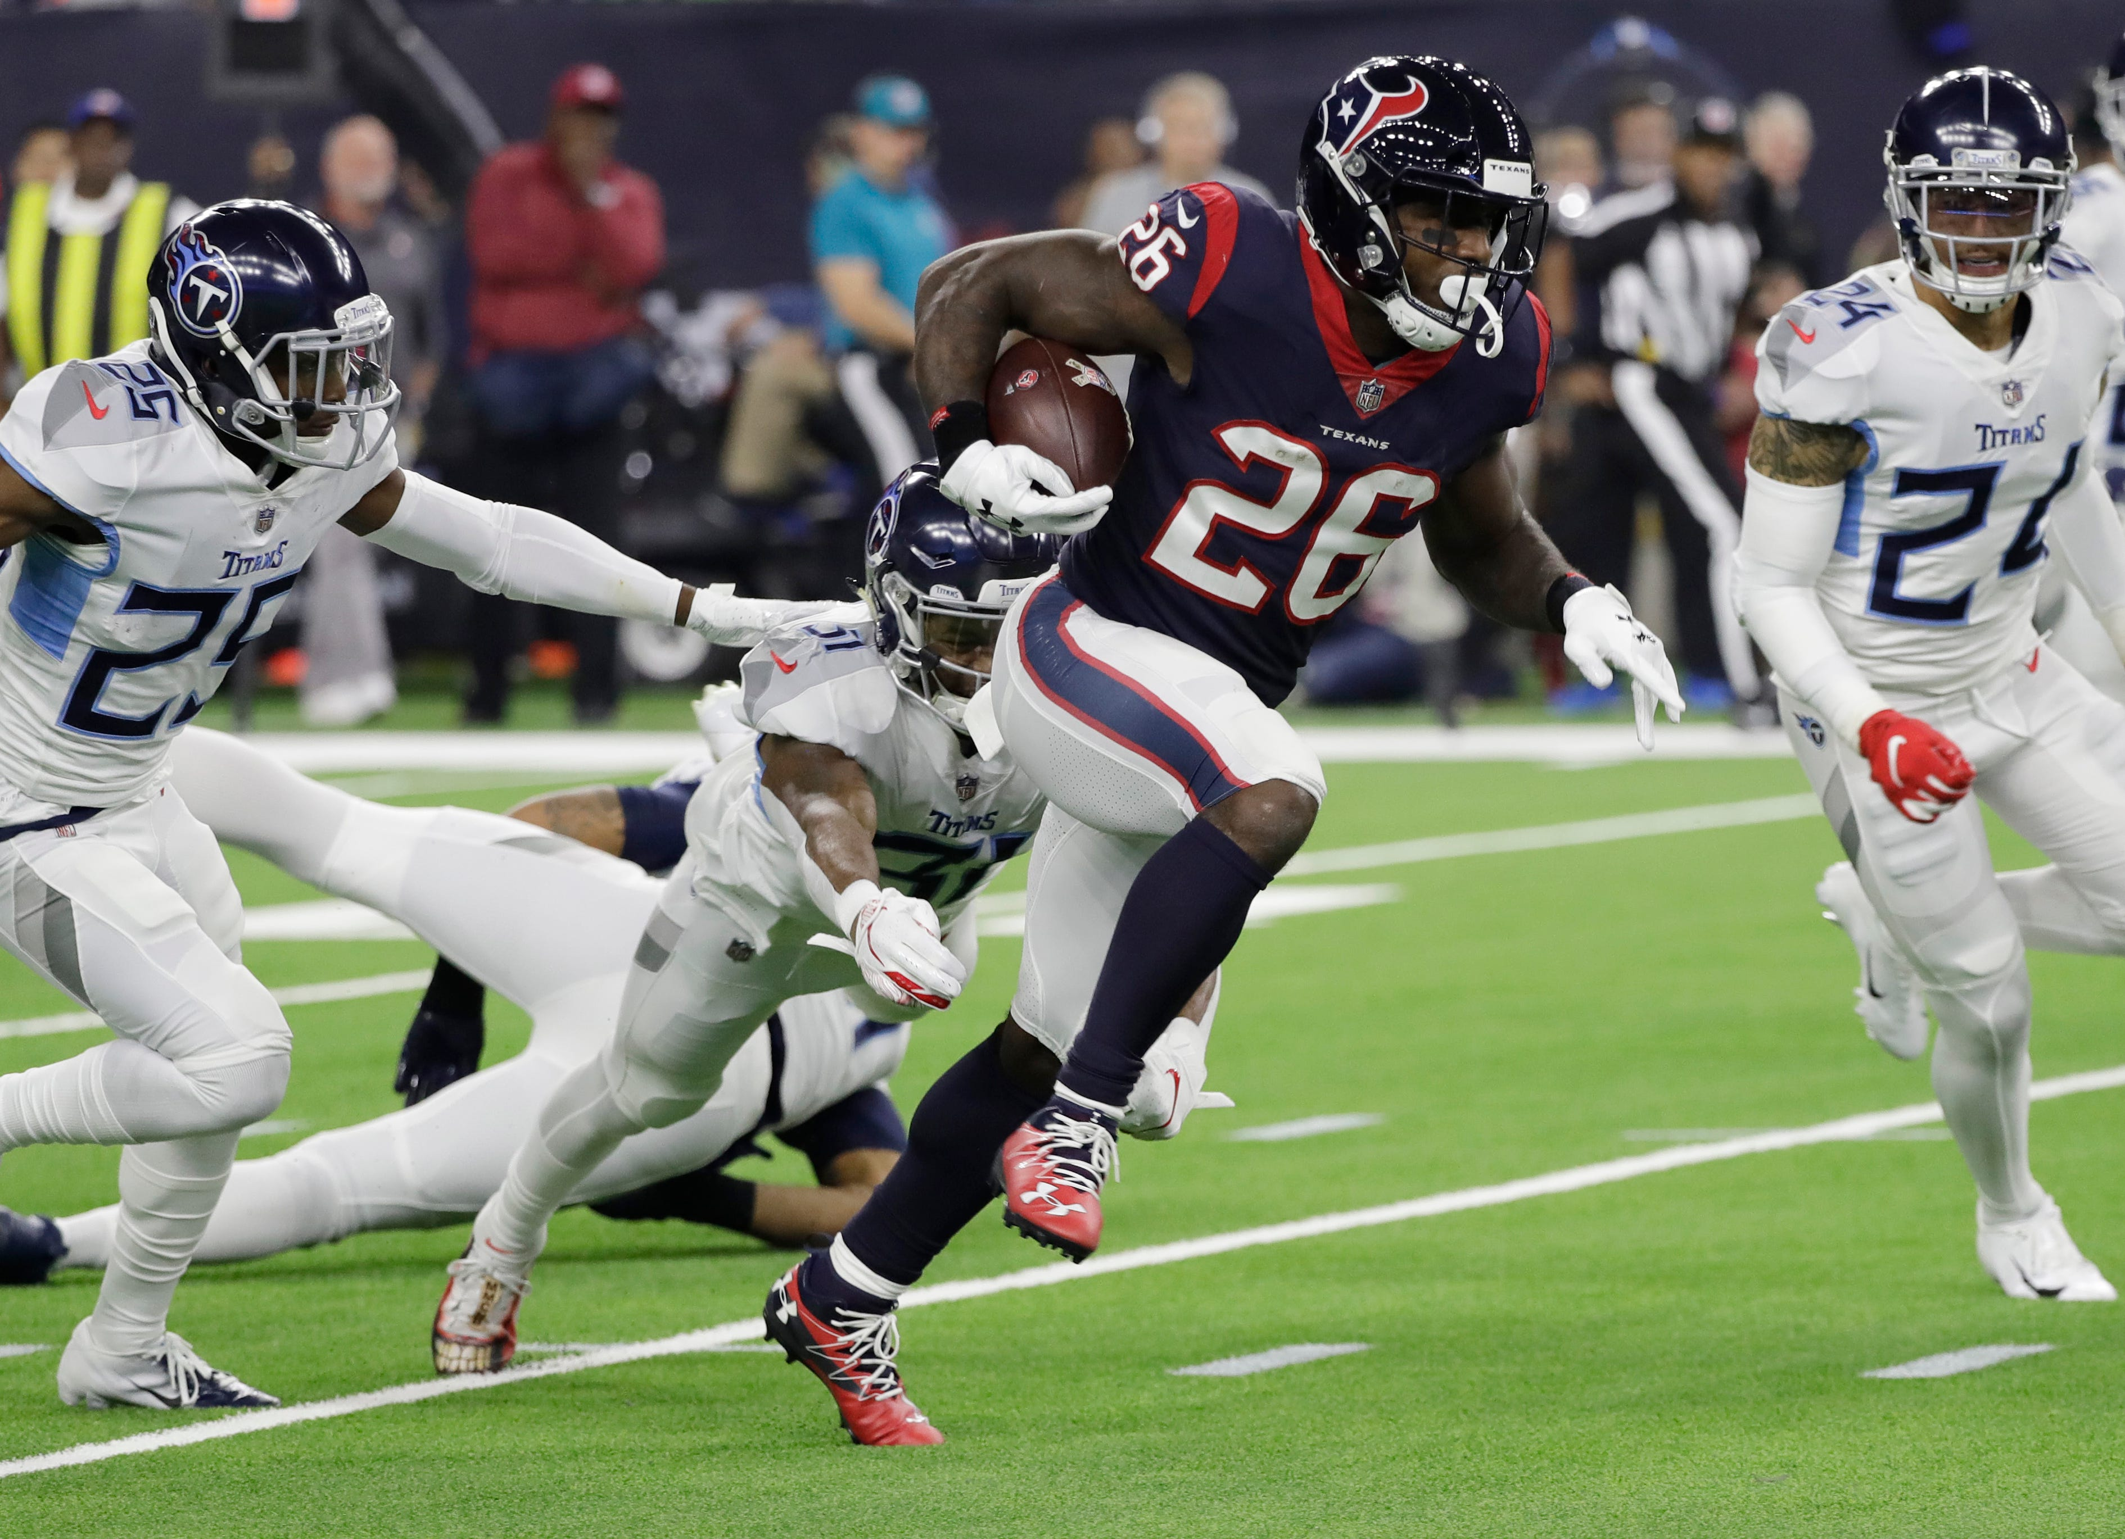
Top 20 teams rank by total “run” made
10,000
7,500
count
5,000
count
2,500
NYJ
CAR
HOU
BUF
SEA
NE
KC
SF
CIN
BAL
DEN
PHI
MIN
DAL
TEN
CHI
NO
WAS
PIT
CLE
posteam
Notes:
Same concept for run play. Team stats are close.
Code:
source="NFL Play by Play 09-18 Updated.csv" play_type="run" | stats count by posteam | sort-count|head 20

Slide 7
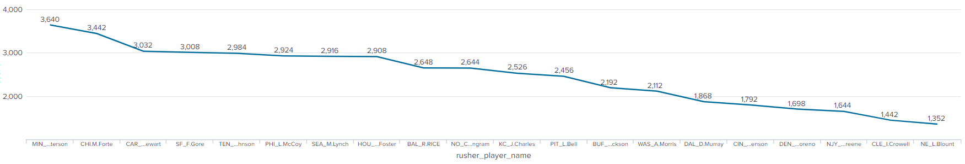
Top players in top 20 team for “run” made
Notes:
Top player stats varies as we have discussed earlier.
Code:
source="NFL Play by Play 09-18 Updated.csv" posteam="nyj" play_type="run" | chart count by rusher_player_name | sort - count| head 1 | append[search source="NFL Play by Play 09-18 Updated.csv" posteam="car" play_type="run" | chart count by rusher_player_name | sort - count| head 1] |append[search source="NFL Play by Play 09-18 Updated.csv" posteam="hou" play_type="run" | chart count by rusher_player_name | sort - count| head 1 ]| append[search source="NFL Play by Play 09-18 Updated.csv" posteam="buf" play_type="run" | chart count by rusher_player_name | sort - count| head 1] | append[search source="NFL Play by Play 09-18 Updated.csv" posteam="sea" play_type="run" | chart count by rusher_player_name | sort - count| head 1] | append[search source="NFL Play by Play 09-18 Updated.csv" posteam="ne" play_type="run" | chart count by rusher_player_name | sort - count| head 1] |append [search source="NFL Play by Play 09-18 Updated.csv" posteam="kc" play_type="run" | chart count by rusher_player_name | sort - count| head 1 ]| append[search source="NFL Play by Play 09-18 Updated.csv" posteam="sf" play_type="run" | chart count by rusher_player_name | sort - count| head 1]| append [search source="NFL Play by Play 09-18 Updated.csv" posteam="cin" play_type="run" | chart count by rusher_player_name | sort - count| head 1 ]| append[search source="NFL Play by Play 09-18 Updated.csv" posteam="bal" play_type="run" | chart count by rusher_player_name | sort - count| head 1]|append[search source="NFL Play by Play 09-18 Updated.csv" posteam="den" play_type="run" | chart count by rusher_player_name | sort - count| head 1 ]| append[search source="NFL Play by Play 09-18 Updated.csv" posteam="phi" play_type="run" | chart count by rusher_player_name | sort - count| head 1] | append[ search source="NFL Play by Play 09-18 Updated.csv" posteam="min" play_type="run" | chart count by rusher_player_name | sort - count| head 1 ]| append[search source="NFL Play by Play 09-18 Updated.csv" posteam="dal" play_type="run" | chart count by rusher_player_name | sort - count| head 1] |append[ search source="NFL Play by Play 09-18 Updated.csv" posteam="ten" play_type="run" | chart count by rusher_player_name | sort - count| head 1 ]| append[search source="NFL Play by Play 09-18 Updated.csv" posteam="chi" play_type="run" | chart count by rusher_player_name | sort - count| head 1]| append[search source="NFL Play by Play 09-18 Updated.csv" posteam="NO" play_type="run" | chart count by rusher_player_name | sort - count| head 1 ]| append[search source="NFL Play by Play 09-18 Updated.csv" posteam="was" play_type="run" | chart count by rusher_player_name | sort - count| head 1] | append[search source="NFL Play by Play 09-18 Updated.csv" posteam="pit" play_type="run" | chart count by rusher_player_name | sort - count| head 1 ]| append[search source="NFL Play by Play 09-18 Updated.csv" posteam="cle" play_type="run" | chart count by rusher_player_name | sort - count| head 1] |replace "L.Bell" WITH "PIT_L.Bell" IN rusher_player_name|replace "I.Crowell" WITH "CLE_I.Crowell" IN rusher_player_name|replace "M.Ingram" WITH "NO_C.M.Ingram" IN rusher_player_name|replace "A.Morris" WITH "WAS_A.Morris" IN rusher_player_name |replace "C.Johnson" WITH "TEN_C.Johnson" IN rusher_player_name|replace "M.Forte" WITH "CHI.M.Forte" IN rusher_player_name|replace "A.Peterson" WITH "MIN_A.Peterson" IN rusher_player_name|replace "D.Murray" WITH "DAL_D.Murray" IN rusher_player_name|replace "K.Moreno" WITH "DEN_K.Moreno" IN rusher_player_name|replace "L.McCoy" WITH "PHI_L.McCoy" IN rusher_player_name |replace "C.Benson" WITH "CIN_C.Benson" IN rusher_player_name|replace "R.Rice" WITH "BAL_R.RICE" IN rusher_player_name |replace "J.Charles" WITH "KC_J.Charles" IN rusher_player_name|replace "F.Gore" WITH "SF_F.Gore" IN rusher_player_name|replace "M.Lynch" WITH "SEA_M.Lynch" IN rusher_player_name|replace "L.Blount" WITH "NE_L.Blount" IN rusher_player_name|replace "A.Foster" WITH "HOU_A.Foster" IN rusher_player_name|replace "F.Jackson" WITH "BUF_F.Jackson" IN rusher_player_name|replace "S.Greene" WITH "NJY_S.Greene" IN rusher_player_name|replace "J.Stewart" WITH "CAR_J.Stewart" IN rusher_player_name|sort-count

Slide 8
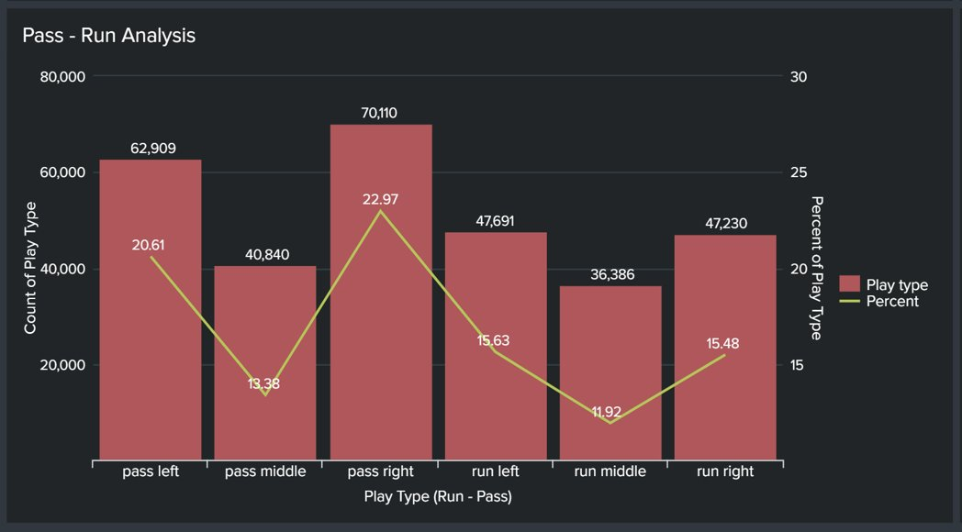

Slide 9
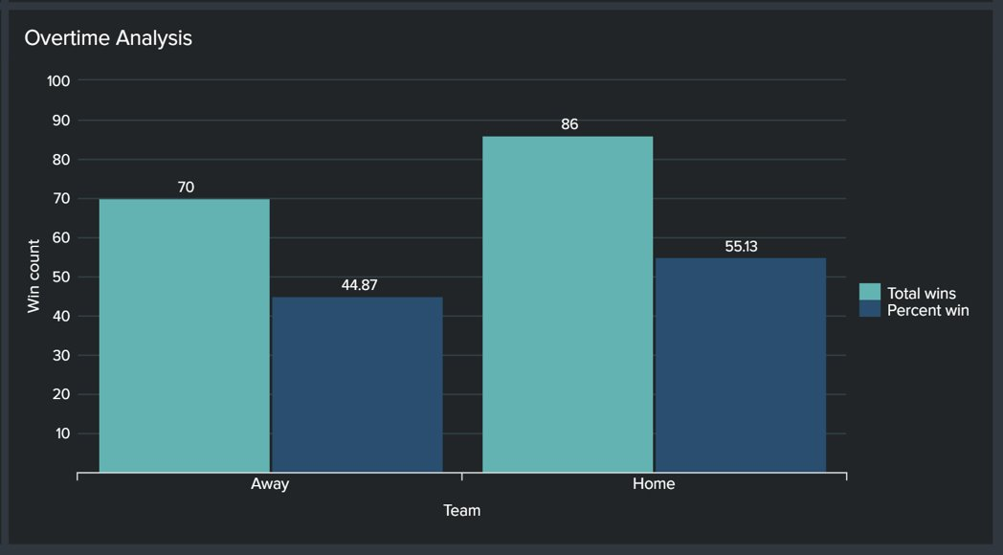

Slide 10
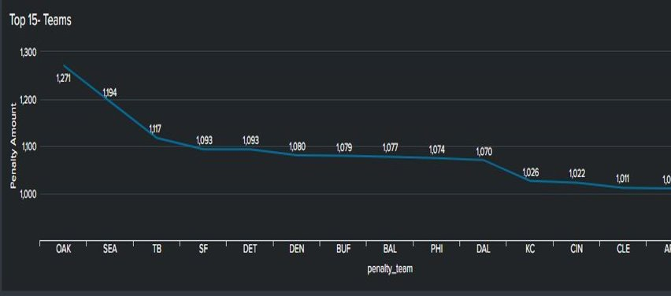
Top 15- Teams with Penalties

Slide 11
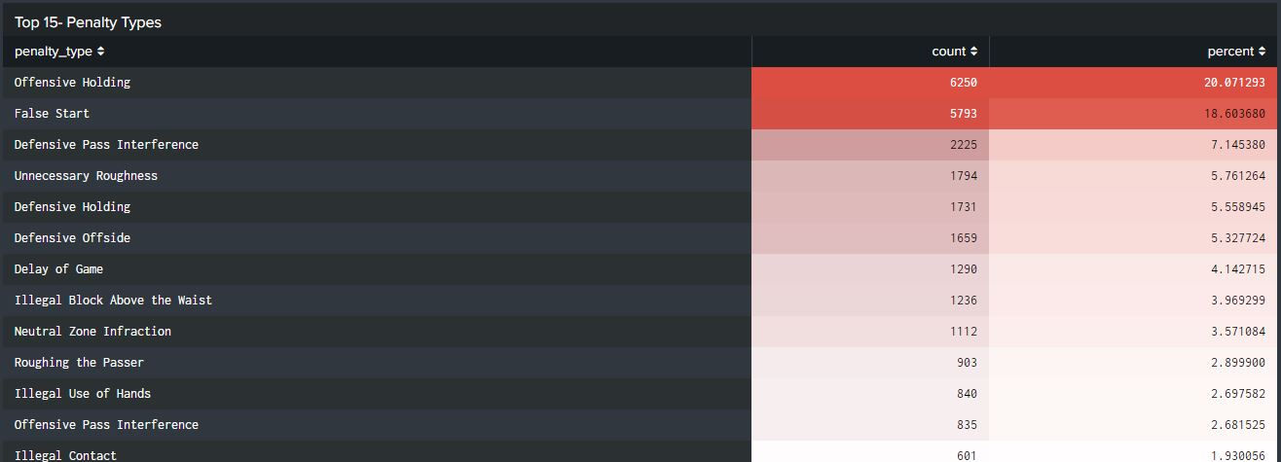
Top 15- Penalty Types

Slide 12
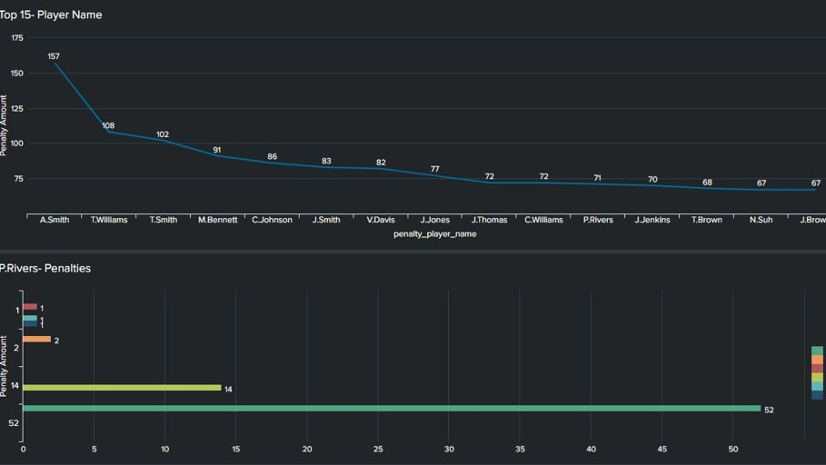
Top 15- Players with Penalties

Slide 13
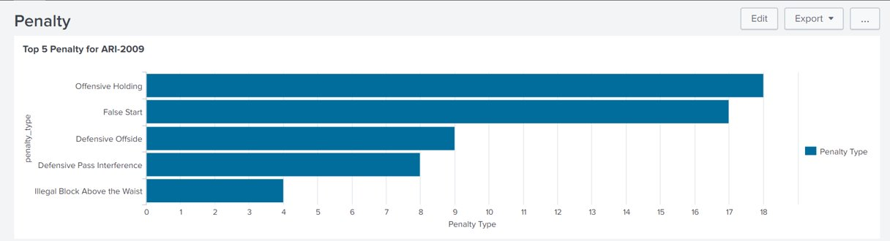
Top 5 Penalty for ARI 2009
Notes:
Code:
index="nfl_final" game_date="*2009" home_team="ari" penalty_type!=NA | top limit=5 penalty_type | rename count as "Penalty Type"

Slide 14
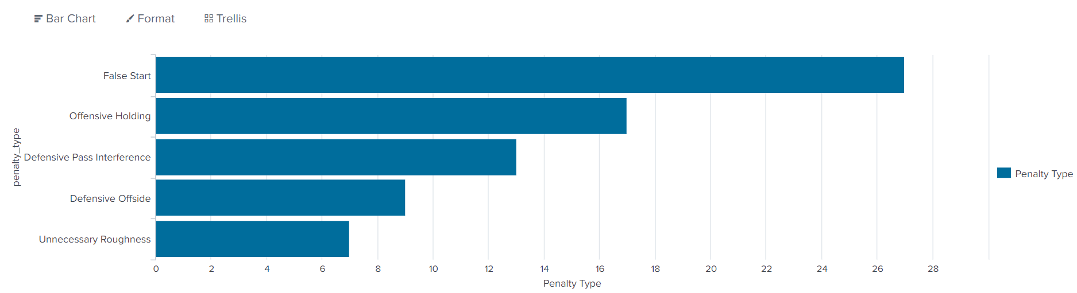
TOP 5 Penalty for ARI 2010
Notes:
Code:
index="nfl_final" game_date="*2010" home_team="ari" penalty_type!=NA | top limit=5 penalty_type | rename count as "Penalty Type"

Slide 15
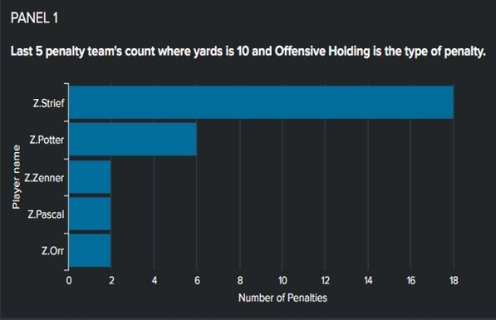
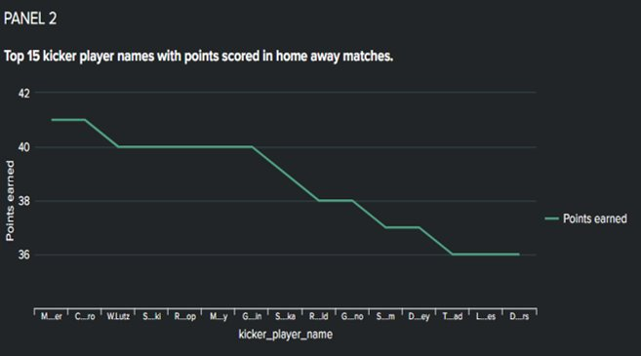

Slide 16
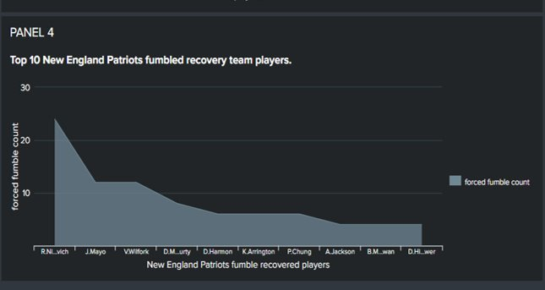
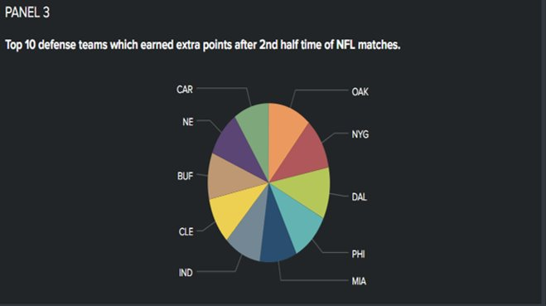

Slide 17
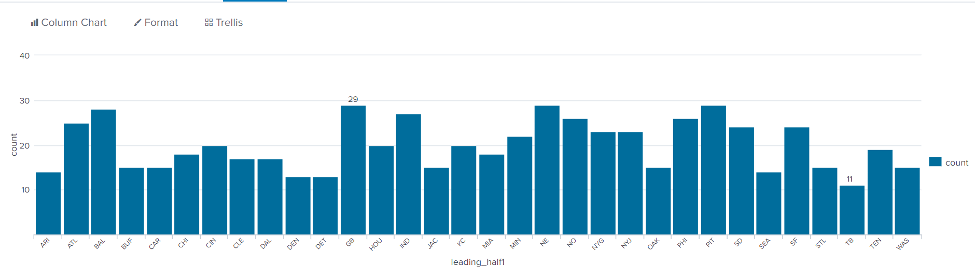
scores in the 1st half of the match by various teams in all years
Notes:
The first dashboard is about the scores in the 1st half and 2nd half of the match by various teams in all years and all of them combined. This helps us analyze how many goals were scored in the matches and which teams were leading the halves.
Code:
index="nfl_final" game_half = "Half1" | dedup away_team, total_away_score, total_home_score, game_date| eval combineScore = total_away_score + total_home_score| eventstats max(combineScore) AS maxscore by game_date away_team | where combineScore=maxscore| table home_team total_home_score away_team total_away_score combineScore| eval leading_half1=if(total_home_score > total_away_score, home_team, away_team)| stats count by leading_half1

Slide 18
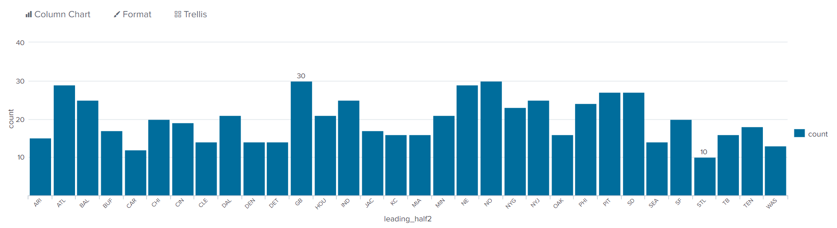
scores in the 2nd half of the match by various teams in all years
Notes:
index="nfl_final" game_half = "Half2" | dedup away_team, total_away_score, total_home_score, game_date| eval combineScore = total_away_score + total_home_score| eventstats max(combineScore) AS maxscore by game_date away_team | where combineScore=maxscore| table home_team total_home_score away_team total_away_score combineScore| eval leading_half2=if(total_home_score > total_away_score, home_team, away_team)| stats count by leading_half

Slide 19
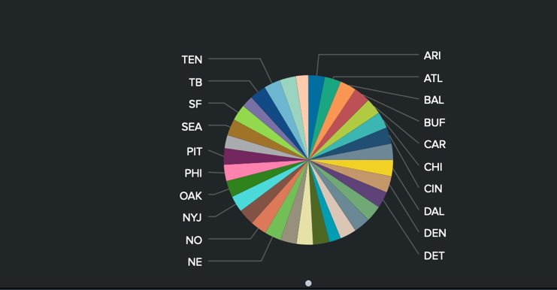
Total matches plays by all teams​

Slide 20
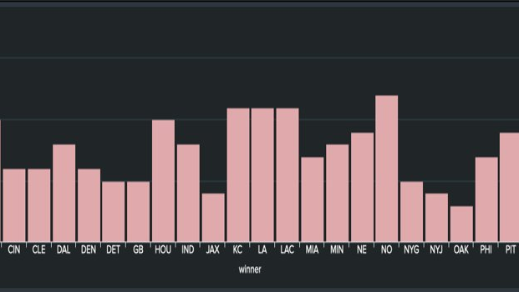
Match Win stats by team in year 2018​

Slide 21
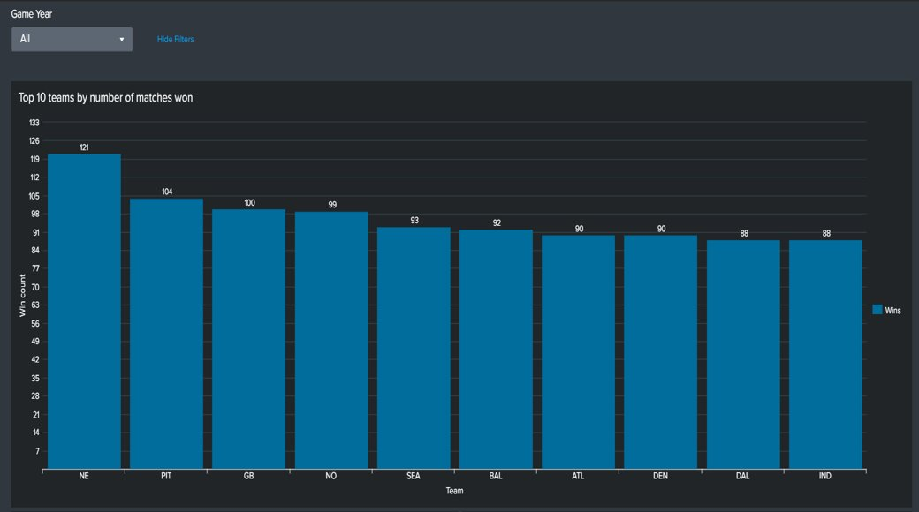

Slide 22
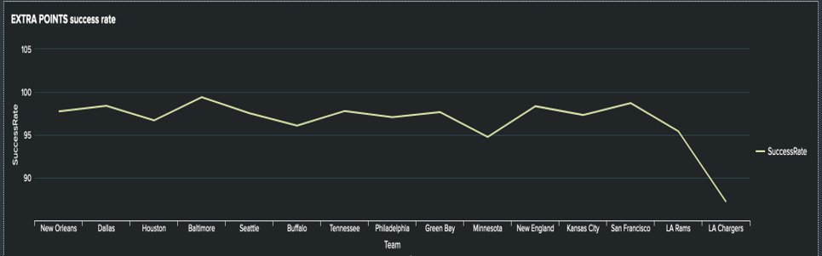
Success rate of Extra Points attempts by top 15 teams​

